Slide 1
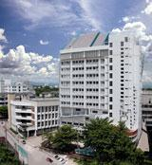
Gerontology and Elderly Health Research Unit
หน่วยวิจัยพฤฒาวิทยาและสุขภาพผู้สูงอายุ
Faculty of Associated Medical Sciences
Chiang Mai University

Slide 2
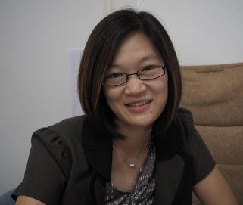
AMS
Physical Therapy (PT)
Occupational Therapy (OT)
Medical Technology (MT)
Radiologic Technology (RT)
อ. หทัยชนก อภิโกมลกร
(หัวหน้าหน่วยวิจัย)
ผศ. ดร. สุรีพร อุทัยคุปต์
(รองหัวหน้าหน่วยวิจัย)

Slide 3
Research
Teaching
Community service
Active ageing and better quality of life

Slide 4
Researchers
Assoc. Prof. Dr. Somporn Sungkarat
Asst. Prof. Dr. Patima Silsupadol
Dr. Sirinun Boripuntakul
Araya Yankai
Asst. Prof. Dr. Sureeporn Uthaikhup
Asst. Prof. Suwit Ariyachaikul
Assoc. Prof. Dr. Aatit Paungmali
Asst. Prof. Dr. Ubon Pirunsan
Asst. Prof. Dr. Patraporn Sitilertpisan
Asst. Prof. Dr. Prapas Pothongsunun
Assoc. Prof. Korakot Hensangvilai
Assoc. Prof. Thanyaluck Sriboonruang
Assoc. Prof. Dr. Jirakrit Leelarungrayub
Assoc. Prof. Dr. Sainatee Pratanaphon
Gait, balance and fall
Musculoskeletal dysfunctions
Neck, knee, back pain
Women health
Oxidative stress

Slide 5
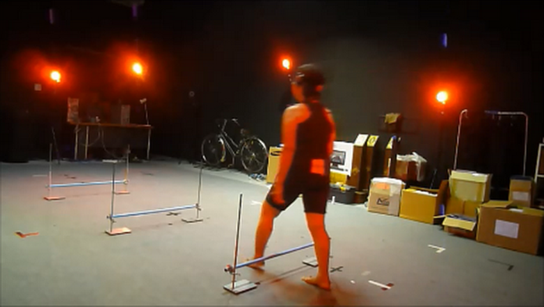
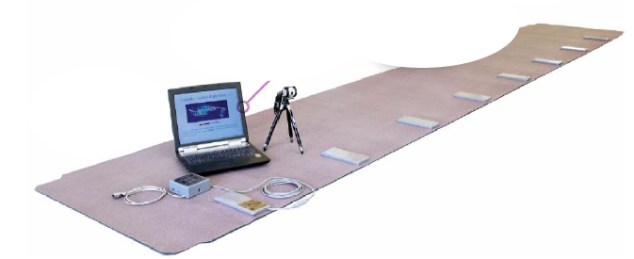
Gait, balance and fall
Evaluate motor and cognitive performance related to risk of fall
Evaluate biomarkers (e.g. blood, brain) in individuals with cognitive impairment
Develop physical and cognitive training programs for individuals with- and without cognitive impairment

Slide 6
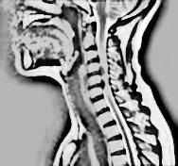
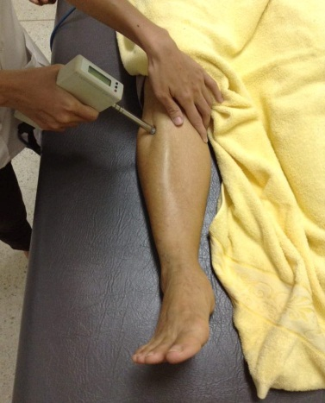
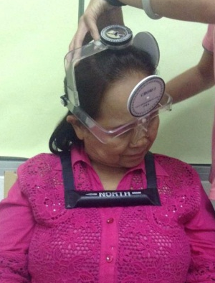
Musculoskeletal dysfunctions
Evaluate musculoskeletal, sensorimotor, and psychological impairments in patients with chronic pain
Develop and evaluate physical therapy approach for patients with chronic pain

Slide 7
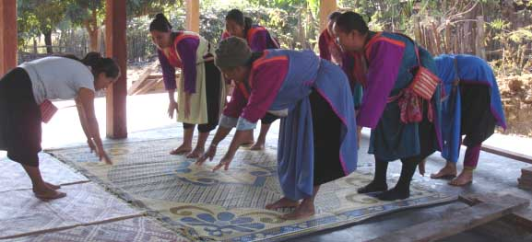
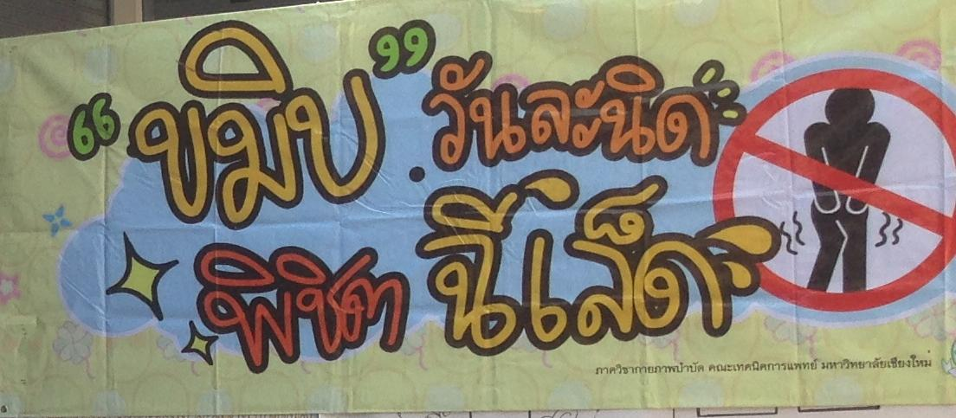
Women health
Evaluate the effect of pelvic floor exercise training in women older adults with urinary incontinence
Develop home-based pelvic floor exercise program: multimedia CD-ROM

Slide 8
Grants
Internal:
Research grant for mid-career, CMU
CMU young researcher fund, CMU
Associated Medical Sciences, CMU
External:
National Research Council of Thailand
Thai Research Funding (TRF) for mid-career
Thai Research Funding (TRF) for young research

Slide 9
Collaboration
National:
CMU
Faculty of Medicine
-Cardiac Electrophysiology Research and
Training Center (CERT)
Faculty of Nursing
Faculty of Veterinary Medicine
The Supreme Patriarch Nyanasanwara Institute of Geriatric Medicine
Notes:
The Supreme Patriarch Nyanasanwara Institute of Geriatric Medicine, Ministry of Public Health, Thailand

Slide 10
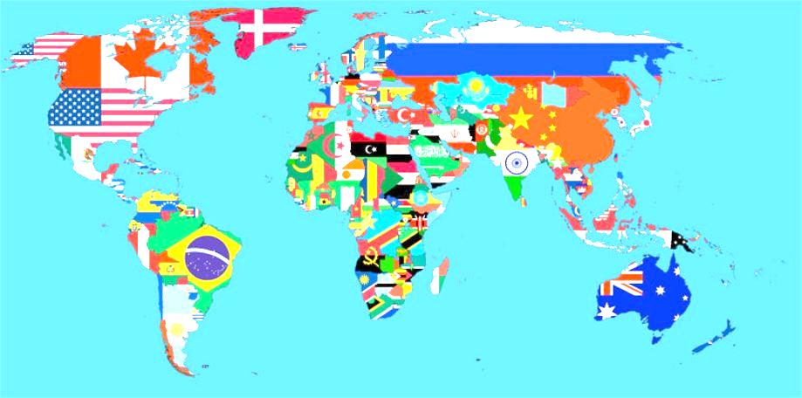
Collaboration
International:
UM, Canada
Mayo clinic, USA
NU, USA
UKM, Malaysia
UQ, Australia
NeuRA, Australia
Notes:
UM=university of Montana
QU = Queenland university
UKM = University Kebangsaan Malaysia
Feinberg school of medicine, Northwestern university

Slide 11
Ongoing research
Gait, balance and fall:
A randomized controlled trial of mind-body exercise: Effect of a 6-month Tai Chi exercise on cognition and serum biomarkers of individuals with MCI
Development and evaluation of a home-based dual-task training program to improve balance performance for older adults
Validity of smartphone-based accelerometer placement on the body versus in the hand, pocket, belt or bag for spatiotemporal gait analysis: A comparison to GAITRite

Slide 12
Ongoing research
Musculoskeletal dysfunctions:
Effectiveness of physiotherapy intervention in seniors with frequent intermittent headache
Age related changes in cross sectional areas, fat infiltration and fat content of the cervical extensor muscles
Changes of muscle cross sectional areas, fat infiltration and fat content in cervical muscles in elders with cervicogenic headache
Development of Physical Fitness Assessment Tool related with Active Dairy Living and High Risk for Disability Movement in Thai Elders

Slide 13
Ongoing research
Women health:
Survey the prevalence of women older adults with urinary incontinence in rural and urban communities

Slide 14
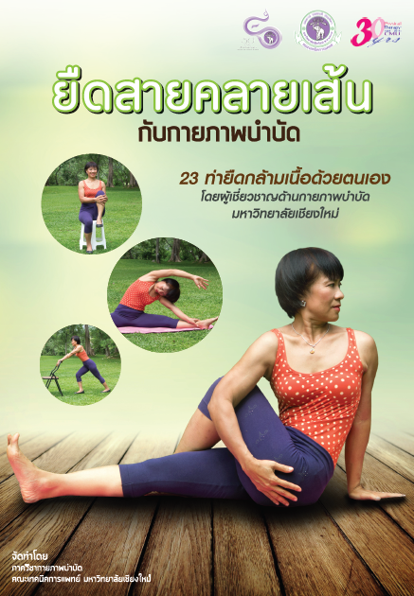
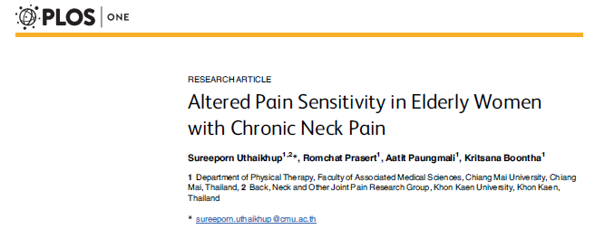
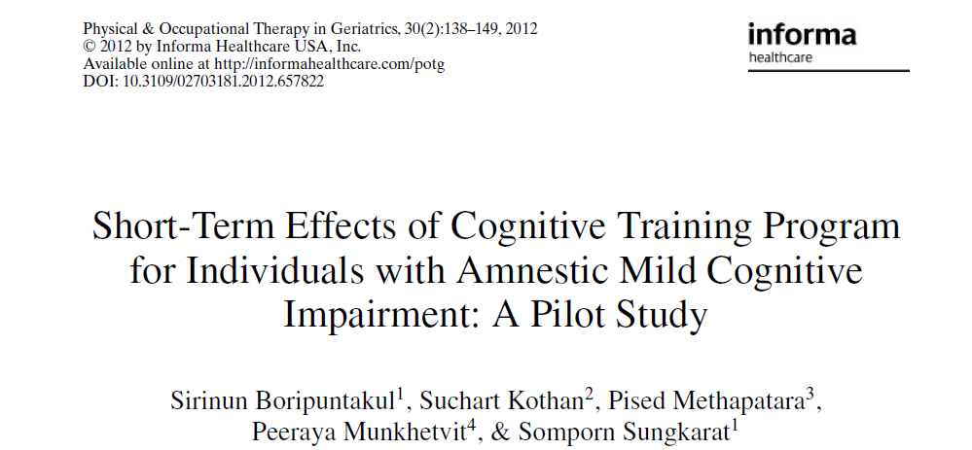
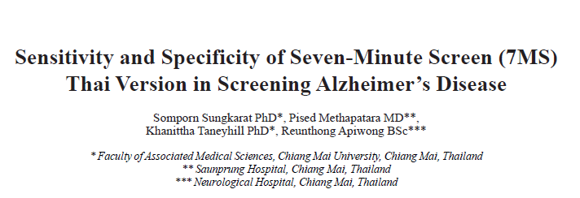
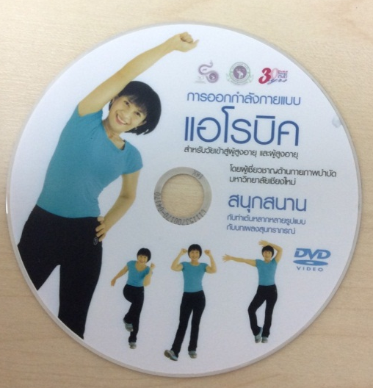
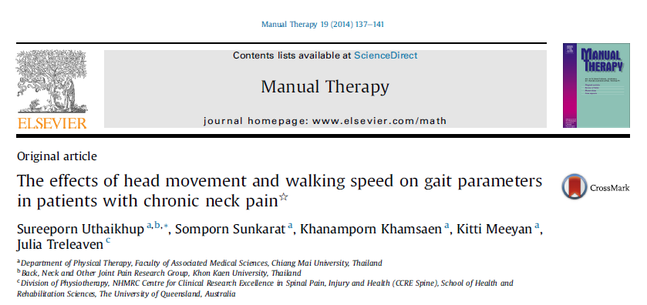
Publication and intellectual property

Slide 15
THANK YOU FOR YOUR ATTENTION

